Slide 1


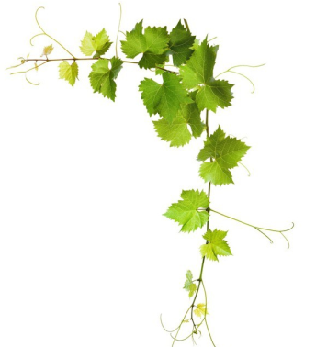
Loukovitis D.¹, Papapetrou M.¹, Papadopoulos O.¹, Kazlari Z.¹, Peristeraki A.¹, Arsenova S.² Bardarova D.², Doncheva D.², Hristova P.², Theocharis S.³, Karagiannidis C.³, Koundouras S.³, Giannakoula A.¹, Aggelopoulos S.¹, Chatziplis D.¹
LABORATORY OF AGROBIOTECHNOLOGY AND INSPECTION OF AGRICULTURAL PRODUCTS
¹Department of Agriculture, International Hellenic University, P.O. Box 141, 57400 Sindos, Thessaloniki, Greece
²Association Prosperity and Development in Bulgaria, 2700 Blagoevgrad, Bulgaria
³School of Agriculture, Aristotle University of Thessaloniki, 54124 Thessaloniki, Greece
Work Package 3: Diagnosis and project Strategy planning
(D3.5.2:Scientific work for the project implementation)
Part A: D3.5.2. «External expertise for DNA analysis»
‘‘SOS for endangered traditional vine varieties-VineSOS’’
Biodiversity in viticulture in the border area of Greece- Bulgaria.
Methods for conservation of biodiversity and its utilization in:
a) the protection of PDO and PGI products,
b) the development of added value products and
c) the development of robust and resistant genotypes.

Slide 2
CONSERVATION OF BIODIVERSITY
Biodiversity: “Biodiversity is the variability among living organisms from all sources, including terrestrial, marine, and other aquatic ecosystems and the ecological complexes of which they are part; this includes diversity within species, between species, and of ecosystems”.
“Conservation of biodiversity is protection, upliftment and scientific management of biodiversity so as to maintain it at its threshold level and derive sustainable benefits for the present and future generation”
There other definitions …
  Most of them however are ad-hoc
    Nevertheless, lets see the conservation of diversity from a more practical farming and breeding (genetic) perspective…..

Slide 3
CONSERVATION OF BIODIVERSITY
Genetic Diversity (C.A. Kearns, 2010)
  Genes are responsible for the traits exhibited by organisms and, as populations of species decrease in size or go extinct, unique genetic variants are lost.
  Since genes hold the "genetic potential“ of various varieties these genes are lost together with these varieties.
    So genetic diversity is an integral part of biodiversity.
  Many of the crops that we grow for food are grown in monocultures of genetically homogeneous individuals.
    The same tend to become in vineyards.

Slide 4
CONSERVATION OF BIODIVERSITY
Genetic Diversity (C.A. Kearns, 2010)
  Because all individuals are the same genetically (i.e. clones), a disease, insect pest, or environmental change that can kill one individual can extirpate an entire crop. Most of our high-yield varieties show significant reductions in yield within about 5 years, as pests overcome the crops’ natural defenses.
    A classical example of this is the Grape phylloxera (Daktulosphaira vitifoliae) in mid-19th century.
  Plant breeders look to wild plant relatives and to locally grown landraces to find new genetic varieties. They can then introduce these genes into crops to renew their vigor.

Slide 5
CONSERVATION OF BIODIVERSITY
Genetic Diversity (C.A. Kearns, 2010)
  According to the UN Food and Agriculture Organization, 96% of the 7,098 US apple varieties cultivated prior to 1904, 95% of the US cabbage varieties, and 81% of tomato varieties, are extinct, and the genes that made these varieties unique are gone.
    ARE WE GOING TO ALLOW THIS TO HAPPEN IN OUR VINES?
      The first step is taken: VineSOS

Slide 6
CONSERVATION OF BIODIVERSITY
How do we conserve biodiversity?
  Conservation programs.
  In situ
    Involves the maintenance of the genetic variation making up PGRFA (Plant Genetic Resources for Food and Agriculture) in the location where it is encountered naturally, either in the wild or within a traditional farming or domestic situation.
  Ex situ
    Ex situ conservation involves maintenance and breeding of endangered plants and animals under partially or wholly controlled conditions in specific areas such as gardens, nurseries etc.
      In vitro techniques
      Gene and Germplasm banks

Slide 7
CONSERVATION OF BIODIVERSITY
How VineSOS contributed to conservation of biodiversity?
How scientific results of VineSOS can be utilized for the conservation of these varieties?
How scientific results of VineSOS can be used to design vine varieties conservation policies within and between countries?

Slide 8
GENETIC CHARACTERIZATION OF LOCAL VARIETES TO BE INCLUDED IN CONSERVATION PROGRAMS

Slide 9
COMMON VARIETIES BETWEEN COUNTRIES IN WHICH COMMON COSNERVATION POLICIES CAN BE APPLIED (i.e. PAMID – PAMIDI, MAVRUD-MAVROUDI, ZUMIATIKO –DIMYAT)

Slide 10
FURTHER RESEARCH FOR SELECTION FOR EX SITU AND IN SITU CONSERVATION

Slide 11
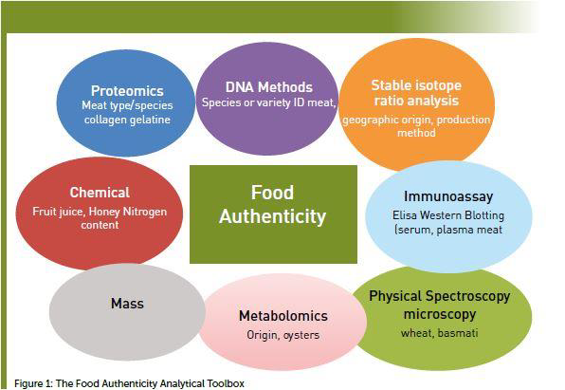
FOOD AUTHENTICITY

Slide 12
PDO AND PGI PRODUCTS
PRODUCTS OF DESTINATION OF ORIGIN
PRODUCTS OF GEOGRAPHICAL ORIGIN
  IT CAN BE DONE WITH OLIVE OIL (Alba et al. 2009)
    WHY NOT WITH WINE?

Slide 13
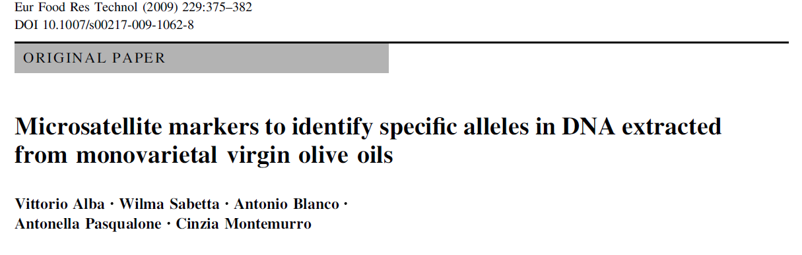
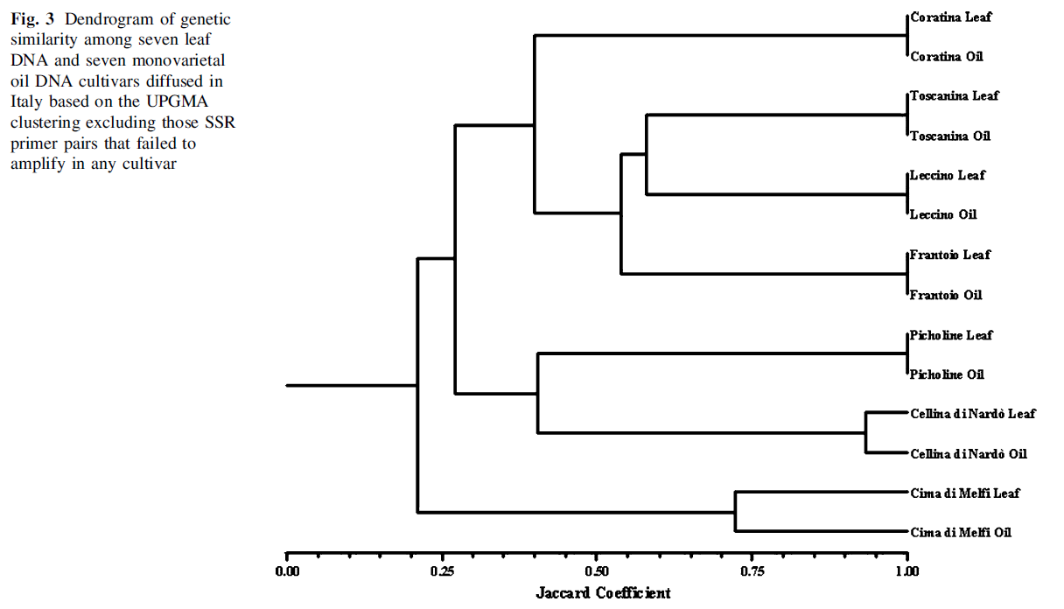
IT HAS BEEN DONE WITH OLIVE OIL WHY NOT WITH WINE?

Slide 14
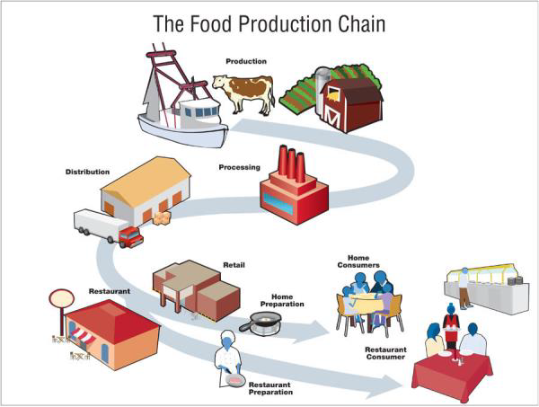
Traceability of products

Slide 15
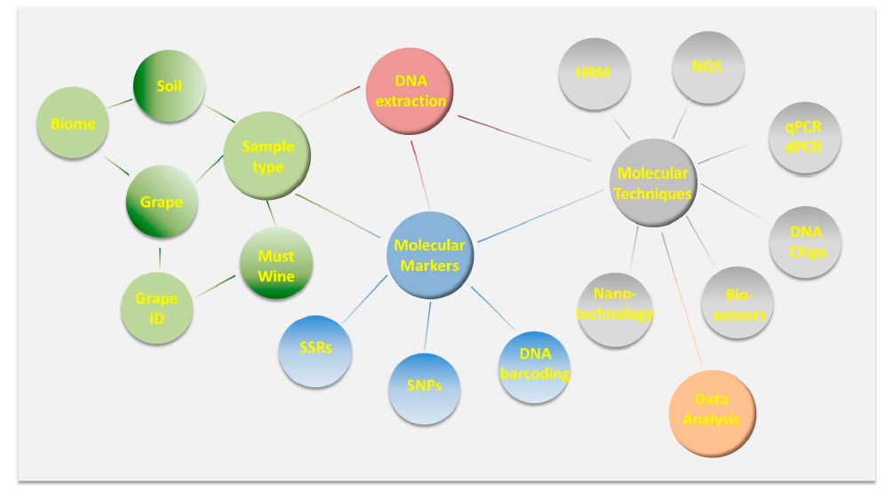
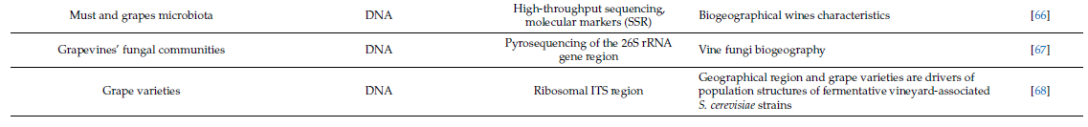
PDO and PGI PROCUCTS (Pereira et al. 2018)

Slide 16


VineSOS next steps towards this direction
Currently in Laboratory of Agrobiotechnology and Inspection of Agricultural Products
  DNA isolation from wine samples is in progress.
    Genotype for the same microsatellites the wine samples
      Genetic discrimination of monovarietal wines from local varieties between each other and from commercial varieties

Slide 17
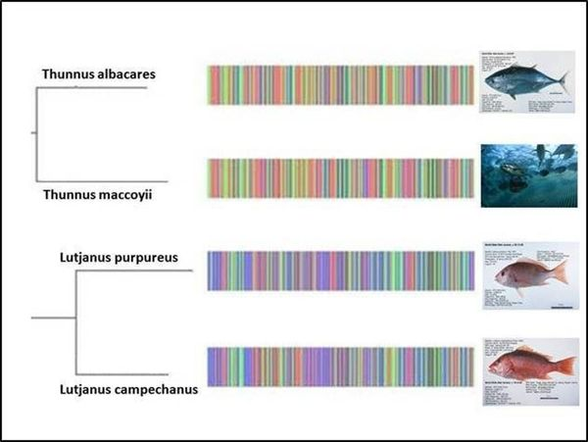
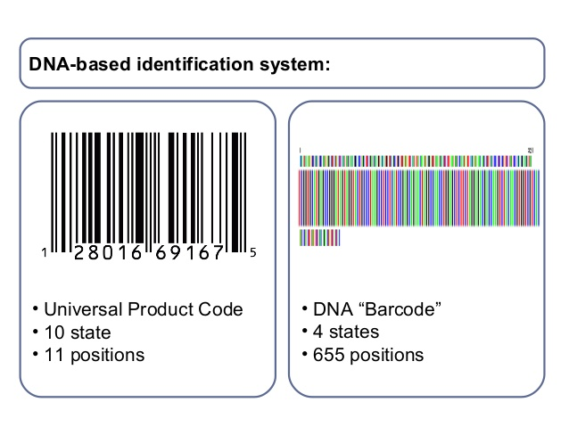
DNA Barcoding
DNA isolation
  From single species/varieties samples
  From mixed species/varieties samples
DNA sequencing
Comparison of the DNA sequence with the species/variatal sequence database
Results

Slide 18
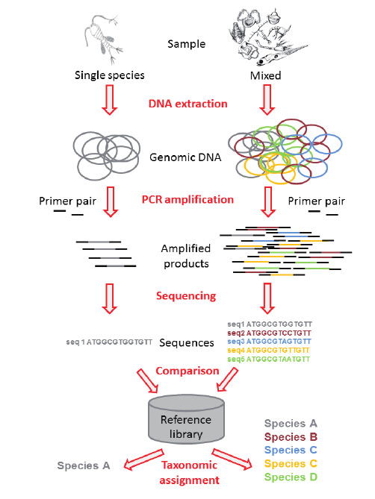
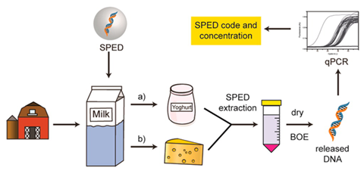
DNA Barcoding
Species origin detection in food

Slide 19

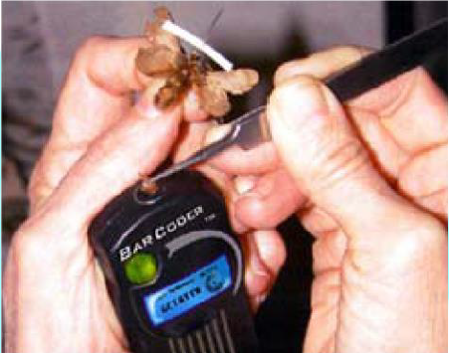

DNA barcoding in the future using Next Generation Sequencing technologies

Slide 20
ADDED VALUE PRODUCTS
EXAMPLES FROM AGRICUTLURE
  BEEF MEAT FROM THE BREED OF ABERDEEN ANGUS BREED HAS A PREMIUM VALUE (HIGHER THAN OTHER BREEDS)
    GENETIC POTENTIAL FOR HIGHER INTREMASCULAR FAT THAT GIVES BETTER TENDERNESS, TASTE AND TEXTURE.
  OLIVE OIL FROM KORONEIKI VARIETY HAS A PREMIUM VALUE
    Olive oils from the Koroneiki variety showed significantly higher monounsaturated/polyunsaturated fatty acid ratios, which are particularly important for the stability of the oil against oxidation.

Slide 21
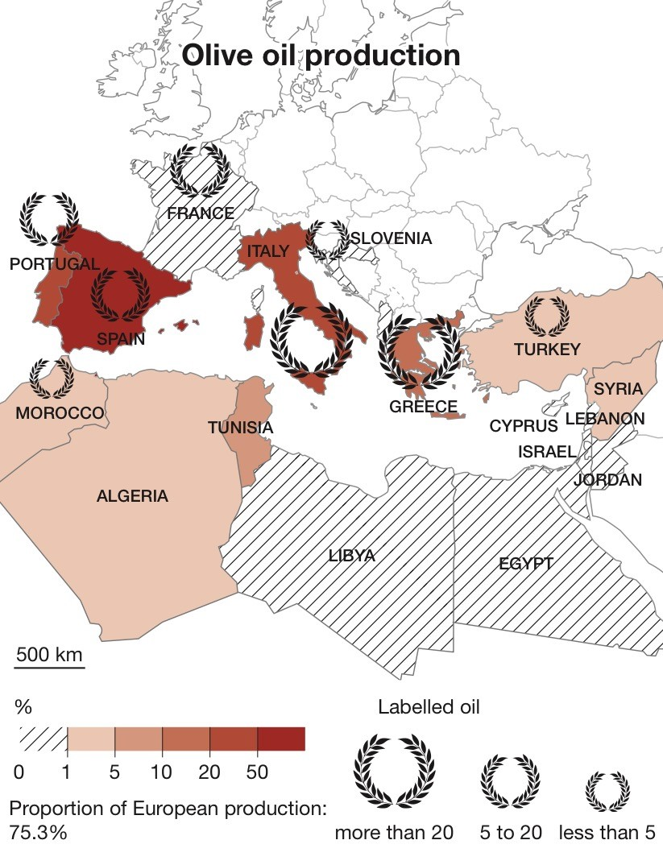
Its been done in olive oil. Why not in wines?

Slide 22
DO WE KNOW THE QUALITY OR EVEN THE AGRONOMIC PROFILE OF THESE HIGHLY GENETICALLY DIFFERENTIATED VARIETIES?

Slide 23
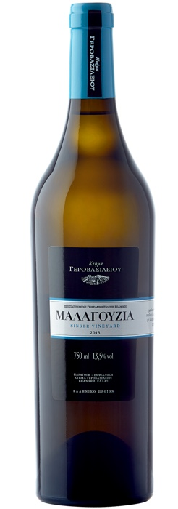
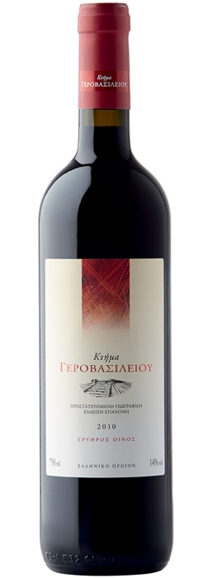
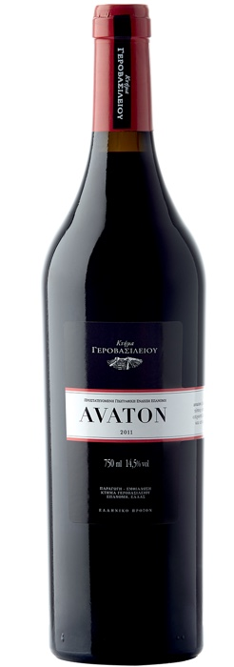
SOME WINERIES WERE QUITE SUCCESFULL WITH ALMOST EXTINCT VARIETIES OR BY USING LOCAL VARIETIES IN MUTIVARIETAL WINES
LIMNIO+ MAVROUDI+
MALAGOYZIA
LIMNIO +

Slide 24
HOW MUCH DO WE KNOW ABOUT THE AGRONOMIC AND GENETIC CHARACTERSTICS OF THESE VARIETIES?
VERY VERY FEW!
MORE RESEARCH IS NEEDED.
  AGRONOMICAL
    ARE THESE VARIETES LESS DEMANDING IN AGRONOMIC PRACTICES?
      ARE LESS IRRIGATION DEMANDING?
      DO THEY MANAGE FINE IN A LOW INPUT FARMING SYSTEM?
      …………………………………………………………..
  GENETICS
    WHY THEY ARE SO DIFFERENT FROM THE REST?
    DO THEY HAVE GENETIC CHARACTERSISTICS WHICH OTHER VARIETIES DO NOT HAVE?
    ARE THEY MORE ROBUST TO EXTREME ENVIRONMENTS?
    ARE THEY MORE RESISTANT TO DISEASES?

Slide 25
FURTHER RESEARCH FOR SELECTION FOR EX SITU AND IN SITU CONSERVATION

Slide 26

FUTURE RESEARCH STEPS
Repeat the analysis using more varieties and more markers.
  Use of Single Nucleotide Polymorphism (SNP) markers
    Greater discriminative ability.
      9K SNPchip
        Our Laboratory (Laboratory of Agrobiotechnology and Inspection of Agricultural Products) is in the process of purchasing a Next Generation Sequencer for medium scale SNP marker genotyping.
Such DNA markers (SNP) can be utilized and improve product traceability
  Labeling
  PDO products
  PGI products

Slide 27
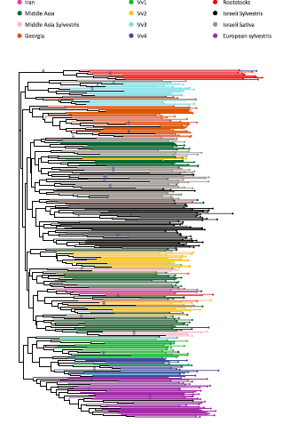
Characterization of grapevine genetic resources in the Holy Land (Israel) using SNP markers
Drori et al. 2017

Slide 28
FUTURE RESEARCH STEPS
Completion of ampelographic book
  ……………………………………….
Extensive agronomy and quantitative genetic studies on those largely genetically differentiated varieties.
  Identify exclusive genetic potential of those varieties
  Develop In Situ conservation programs
    To promote and propagate any unique genetic potential of those varieties.
Quality micro-profile of must and wine from those varieties and their use in wine products.

Slide 29

Published work
Papapetrou, M.; Loukovitis, D.; Papadopoulos, O.; Kazlari, Z.; Peristeraki, A.; Arsenova, S.; Bardarova, D.; Doncheva, D.; Theocharis, S.; Karagiannidis, C.; Koundouras, S.; Giannakoula, A.; Aggelopoulos, S.; Chatziplis, D. Genetic Diversity of Local Greek and Bulgarian Grapevine (Vitis Vinifera L.) Varieties. Diversity 2020, 12(7), 273. https://doi.org/10.3390/d12070273
Dimitrios LOUKOVITIS, Maria PAPAPETROU, Orestis PAPADOPOULOS, Zoi KAZLARI, Anastasia PERISTERAKI, Slavina ARSENOVA, Desislava BARDAROVA, Serafeim THEOCHARIS, Constantinos KARAGIANNIDIS, Stefanos KOUNDOURAS, Anastasia GIANNAKOULA, Stamatis AGGELOPOULOS, Dimitrios CHATZIPLIS. GENETIC DIVERSITY OF GREEK AND BULGARIAN GRAPEVINE (VITIS VINIFERA L.) VARIETIES.

Slide 30
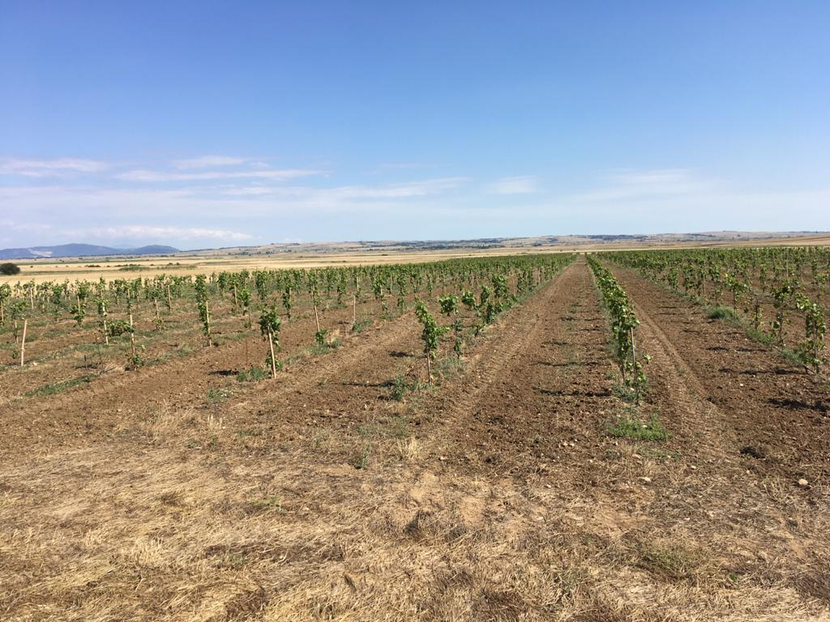
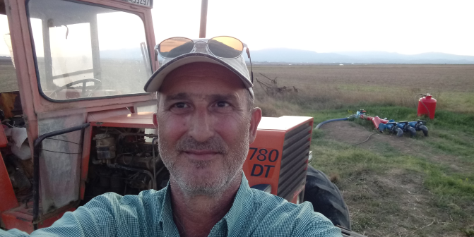





Thank you very much for your attention!

